Slide 1
TEST CASE
What is a Test Case?
The test case is defined as a group of conditions under which a tester determines whether a software application is working as per the customer's requirements or not. Test case designing includes preconditions, case name, input conditions, and expected result. A test case is a first level action and derived from test scenarios.
Types of Test Cases:-
Function test cases:-
In functional testing or if the application is data-driven, we require the input column else; it is a bit time-consuming.
Integration test cases:-
In this, we should not write something which we already covered in the functional test cases, and something we have written in the integration test case should not be written in the system test case again.
System test cases-
We will write the system test cases for the end-to-end business flows. And we have the entire modules ready to write the system test cases.

Slide 2
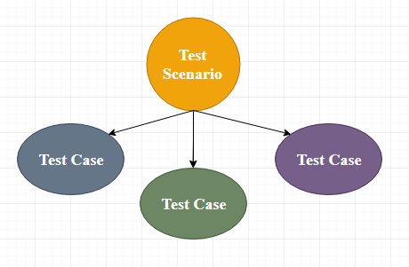
Check Login Functionality there many possible test cases are:
Test Case 1: Check results on entering valid User Id & Password
Test Case 2: Check results on entering Invalid User ID & Password
Test Case 3: Check response when a User ID is Empty & Login Button is pressed, and many more
This is nothing but a Test Case.

Slide 3
When Do We Write Test Cases?
Before development:
Test cases could be written before the actual coding as that would help to identify the requirement of the product/software and carry out the test later when the product/software once gets developed.
After development:
Test cases are also written directly after coming up with a product/software or after developing the feature but before the launching of a product/software as needed to test the working of that particular feature.
During development:
Test cases are sometimes written during the development time, parallelly. so whenever a part of the module/software gets developed it gets tested as well.
Why Write Test Cases?
We will write the test for the following reasons:
To require consistency in the test case execution
To make sure a better test coverage
It depends on the process rather than on a person
To avoid training for every new test engineer on the product

